Slide 1
Final Mini Project Demonstration
Project Title : Blockchain based IoT security model
Project ID : MPW20SR01
Project Guide : Prof. Sunitha
Project Team : Kruthik JT PES1201701509
Ramakrishnan K PES1201701906

Slide 2
Project Abstract and Scope
Blockchain is a distributed ledger that helps in enhancing the security of a system by monitoring the transactions in the system.
The Internet of Things is a system of machines that can communicate with each other without human interaction. IoT systems generate data and transfer it among the devices in the system.
Blockchain is used to monitor the transfer of data among the various devices to prevent illegitimate transactions and corruptions of existing data.

Slide 3
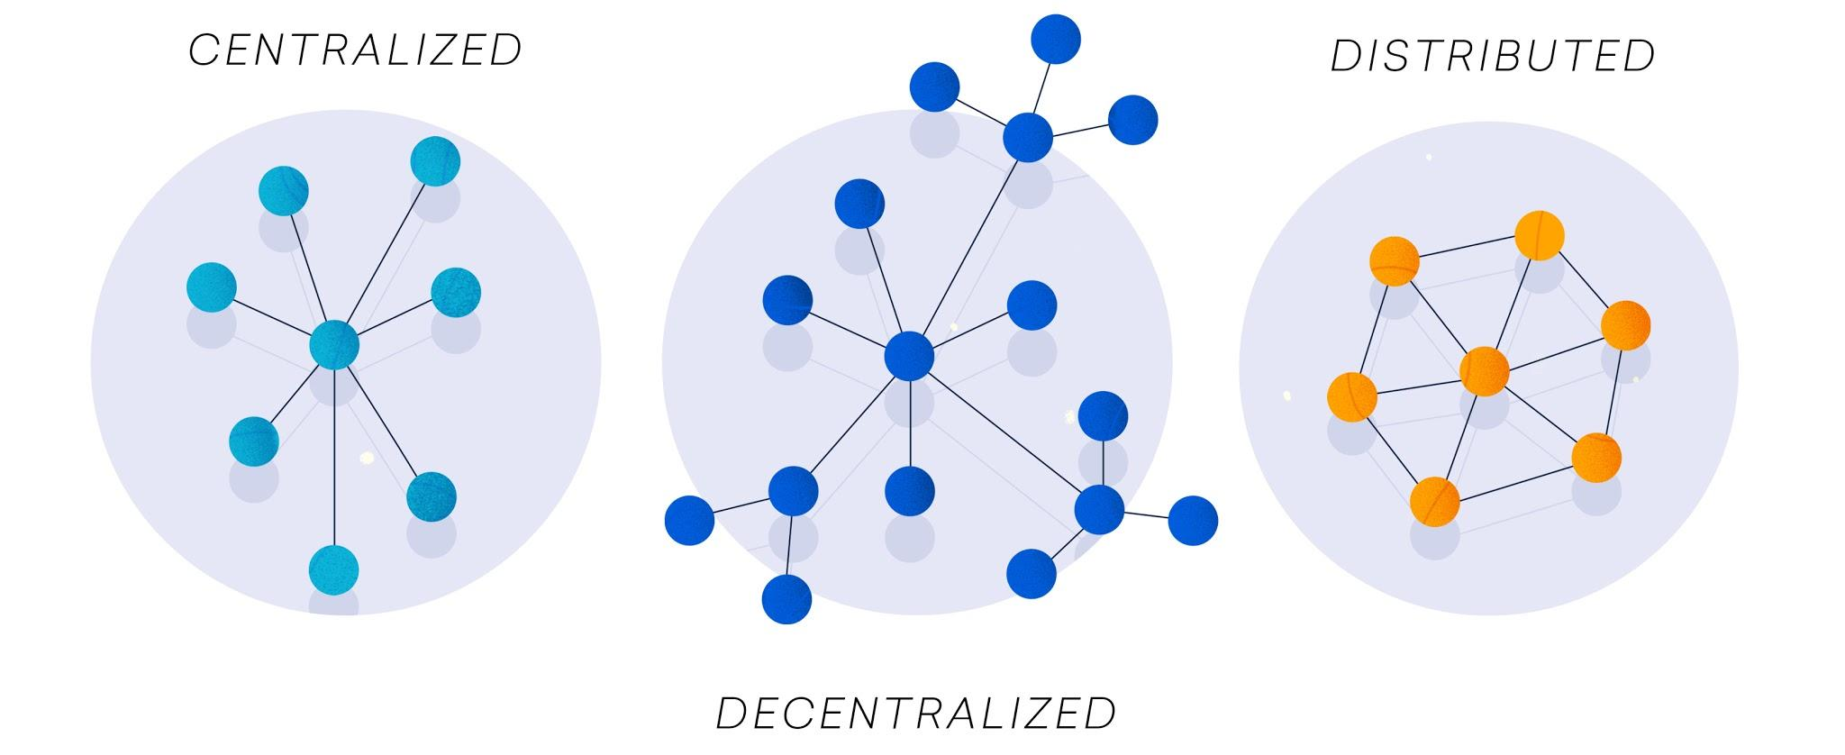
Project Abstract and Scope
Providing security to the ever-increasing ecosystem of complex IoT devices using blockchain.
The objective is to provide a decentralized security mechanism to IoT device transactions using blockchain.
Blockchain provides a secure, decentralized and public method of exerting security on IoT devices.

Slide 4
WHY USE BLOCKCHAIN FOR IOT DEVICES?
Possible Threats:
Camera: Home cameras can be exploited to invade privacy and also personal security.
https://www.nytimes.com/2019/12/15/us/Hacked-ring-home-security-cameras.html
HVAC: A Cyber criminal can adjust the temperatures to overheat the server rooms and corrupt data.
https://www.computerworld.com/article/2487452/target-attack-shows-danger-of-remotely-accessible-hvac-systems.html
Voice assistant: Personal data can be compromised in a client server architecture.
https://www.securitymagazine.com/articles/91220-asuswrt-and-amazon-alexa-products-compromised-in-data-breach

Slide 5
Design Approach
Design:
The blockchain used is Ethereum, it is an open source blockchain platform making it easier for developers hence suitable for this project.
Ethereum provides developers with Smart contracts.
Alternate design:
Simulate a blockchain environment and deploy the project onto that.

Slide 6
Design Constraints, Assumptions & Dependencies
Design Constraints:
Not suitable for IoT devices with lesser computational power, as they are not capable of running CPU intensive tasks.
Dependencies:
Processing power and time: Not all the devices present in the IoT ecosystem can run encryption algorithms at guaranteed speeds.
Storage: Blockchains' ledger grows overtime, storing them is beyond the scope of devices like sensor with minimal storage.
Compliance: A completely new ecosystem without any prior solid work.
Legal implication: Data privacy legislation

Slide 7
Design Description/UI Design
The system can be logically divided into 3 subsystems:
User Interface
IOT
Blockchain platform
The user interface facilitates interaction with the blockchain. It enables the users to submit transaction proposals to the blockchain network for services such as user enrollment, device registration, and task generation services provided by the blockchain network
The IOT subsystem handles all the IOT devices in the system and ensure that the data generated by the IOT system is available on demand, through the user interface.
The Blockchain platform manages and maintains the distributed ledger. It provides the security layer over the IOT system.

Slide 8
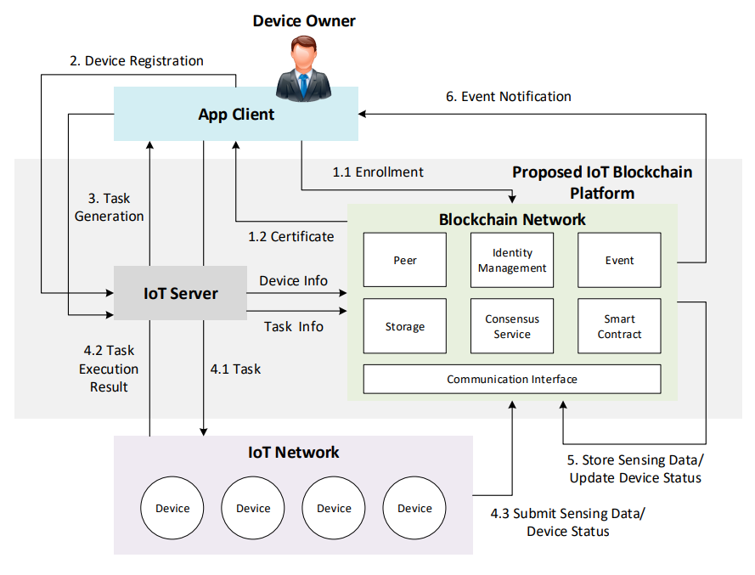
System Workflow

Slide 9
Design Description
HVAC
CAMERAS
VOICE ASSISTANT
WEB BASED FRONTEND

Slide 10
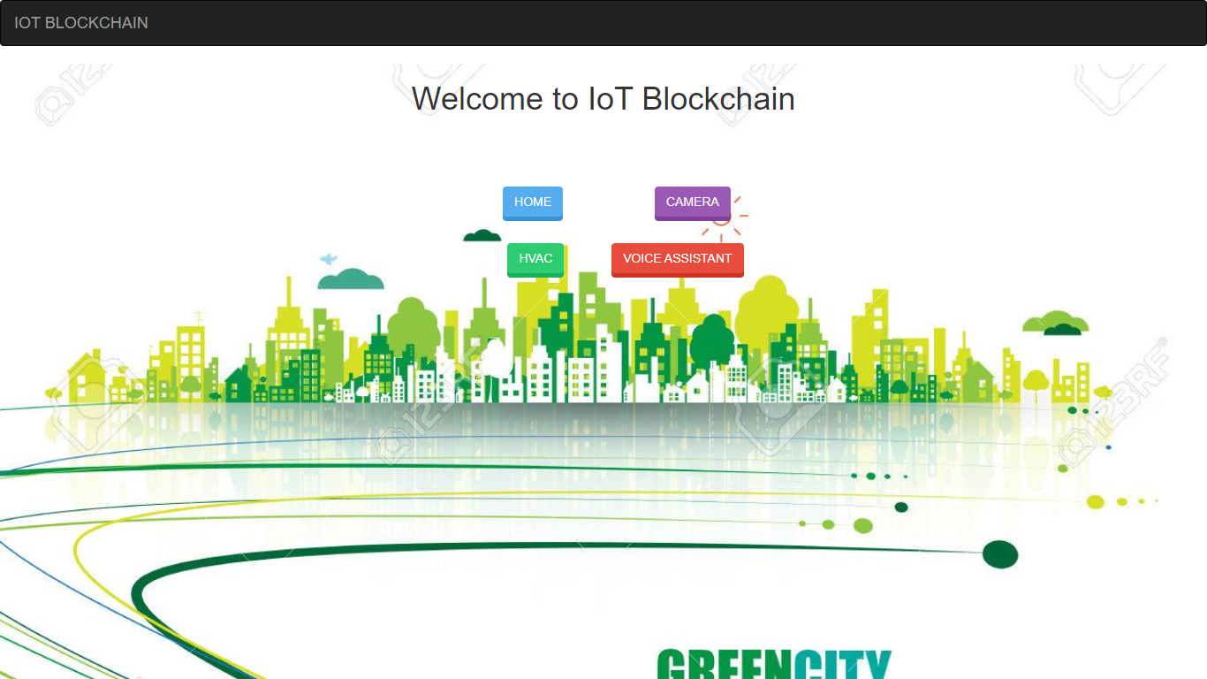
UI Design
Home Page

Slide 11
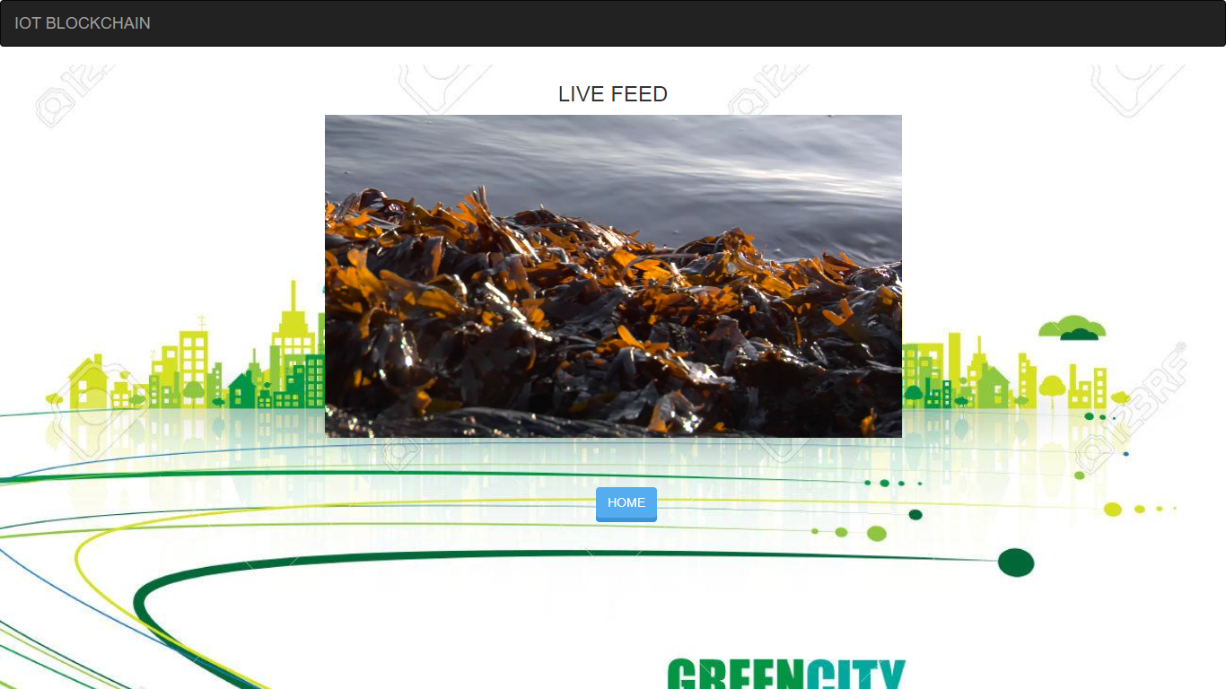
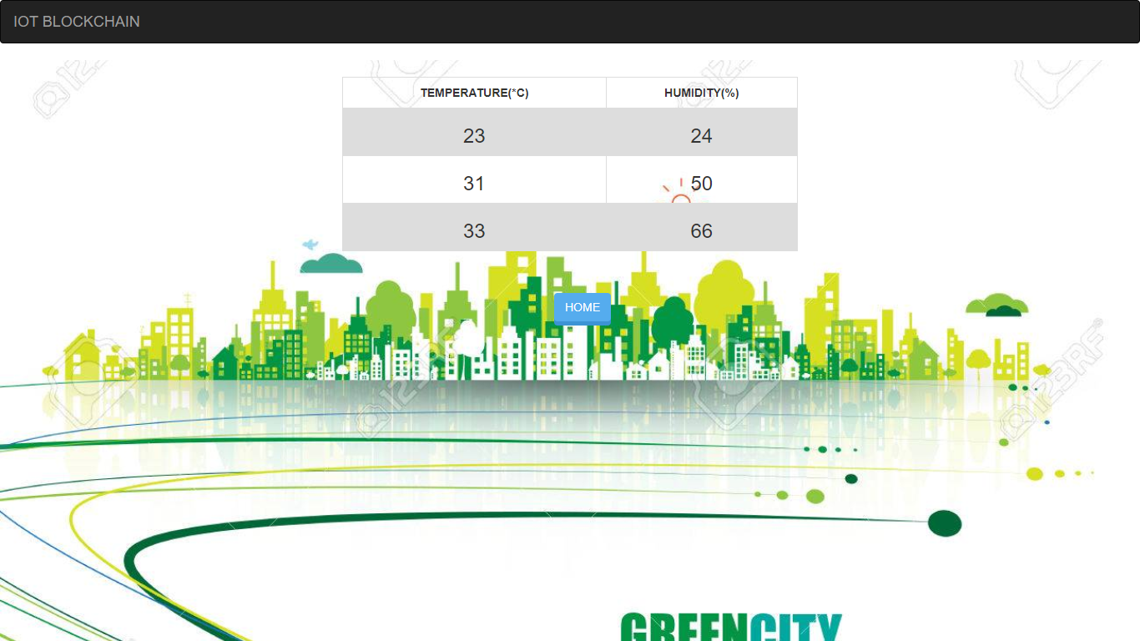
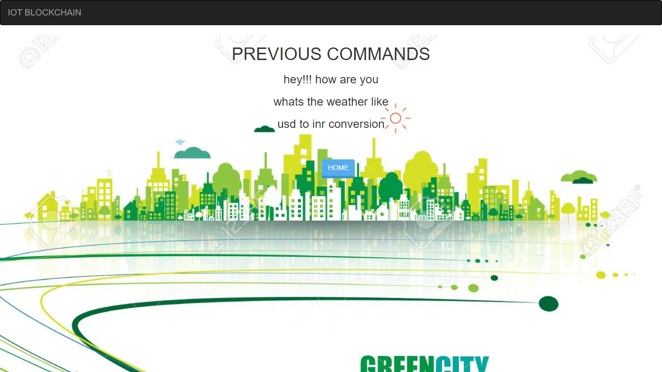
UI Design
Camera
HVAC
Voice Assistant

Slide 12
Technologies Used
TECHNOLOGIES
USED
ETHEREUM
IoT DEVICE
TECHNOLOGY
CRYPTOGRAPHY
Notes:
‹#›

Slide 13
Results and Conclusion
Understanding the fundamentals of the project.
Deployment of the project onto the blockchain.
Smart contracts to write to the blockchain and read from it.
Web based interface to interact with IoT devices.
Notes:
‹#›

Slide 14
Results and Conclusion
Securing the data can establish data privacy and eliminate data forgery and data tampering. These measures will improve the user experience and trust on the IoT system.
Access control is guaranteed by ensuring that only registered devices can access the blockchain. Further a decentralized and immutable nature enforces data availability and security.
Data forgery is prevented by the use of SHA256 hashing to encrypt the data before storing it in the blockchain.
Other attacks such as man in the middle are avoided by the use of the nonce field in the blockchain.
Notes:
‹#›

Slide 15
Q & A

